Slide 1
Redis session management
sharing session between different applications

Slide 2
Technology & Platform
Platform: Java, Spring Boot, Redis Server
Documents: Architecture Diagram
Plugins: Cloud Eureka & Zuul Proxy, Redis plugin

Slide 3
What & Why Dependency injection
It is offer us a centralized session management.
Maintain sessions in a common location for all instances to share.
Consistent Hashing — Load balancer decides which instance to send the request to.
Redis is a fast In-memory solution for caching. It will cache the Spring Session object in Redis.

Slide 4
Points Covered
Handling redis session in a micro service architecture.
Enabling Redis session server in the system and in applications.
Centralized and scalable session management.
Sharing session between applications.

Slide 5

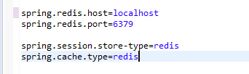
Redis properties

Slide 6
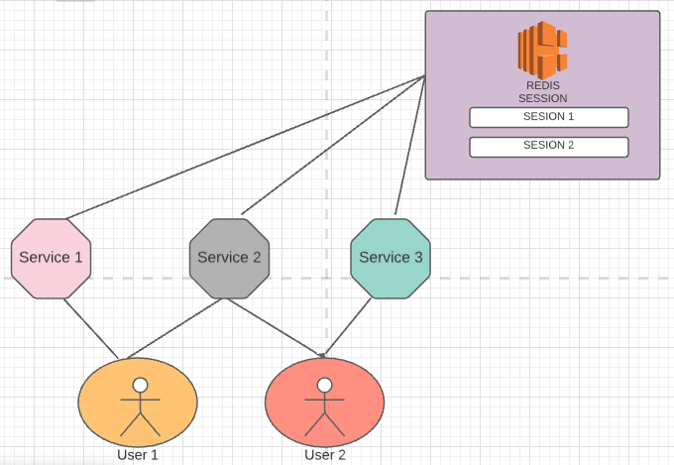
Architecture diagram

Slide 7
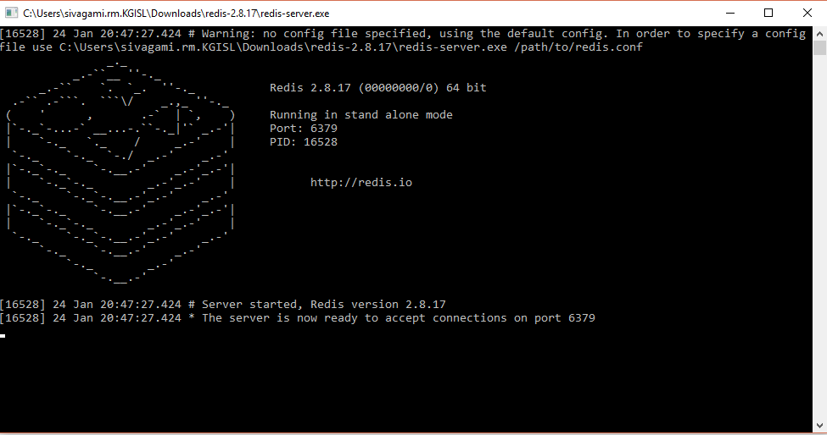
Redis Session Server

Slide 8
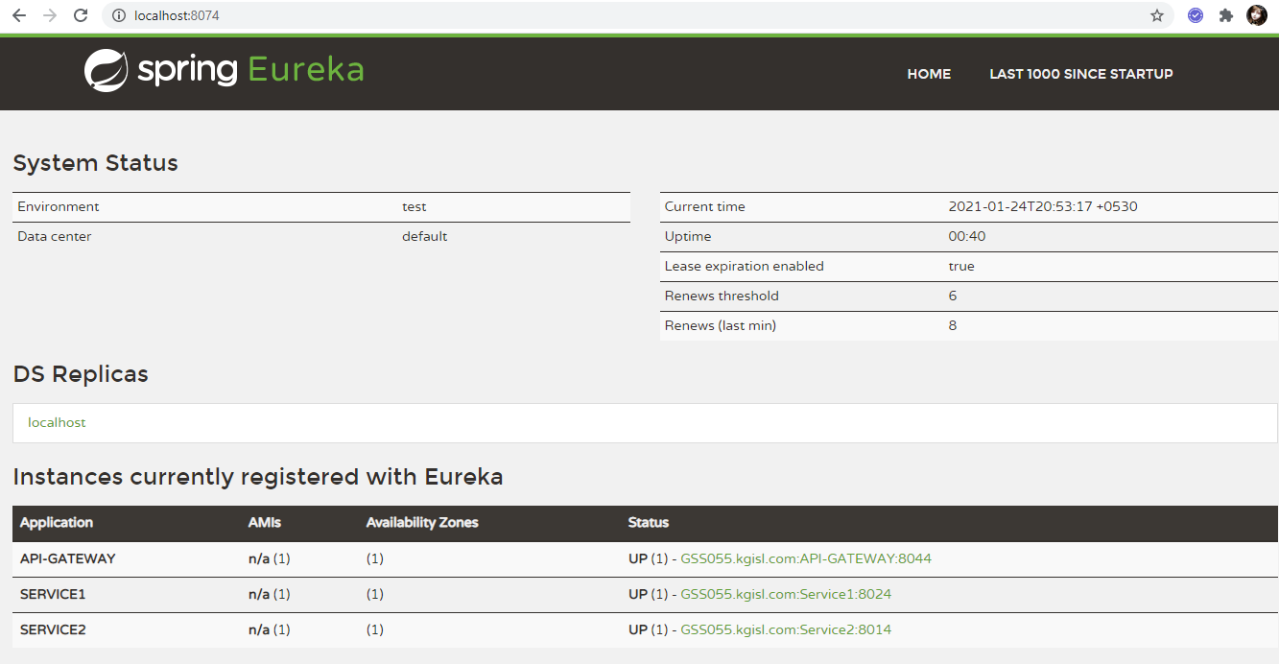
Micro service

